Slide 1
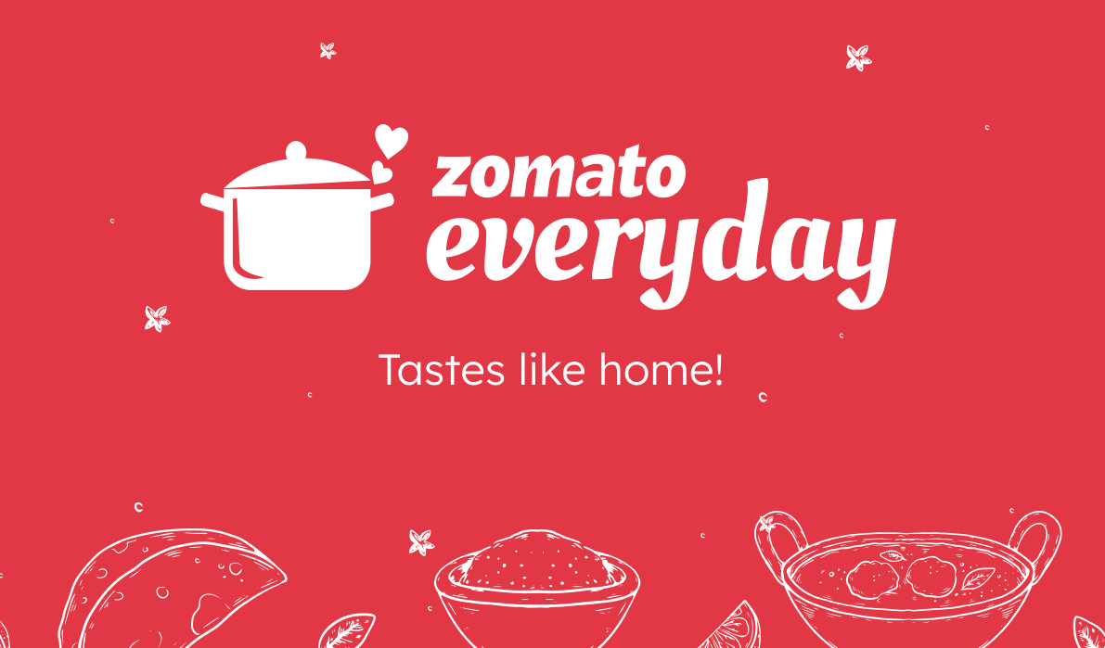
Group No. 5
P570
1) Choutali Ghosh
2) Sana Parveen
3) Dnyaneeshwar Ashwin koradiya
4) Mahajan Akash Sharad
5) Subham Kumar Mahata
6) Arunav Sinha
7) Rajpraveen RT

Slide 2
Introduction
Founding (2008): Zomato was founded in July 2008 by Deepinder Goyal and Pankaj Chaddah in New Delhi, India, under the name "Foodiebay." It started as an online restaurant discovery platform. Zomato is an Indian food delivery startup restaurant aggregator. It primarily provides concrete information, menus, and user reviews of the restaurants. Along with this, Zomato also has food delivery options from partnered restaurants in the selected cities. All of it started when the founders, Deepinder Goyal and Pankaj Chaddah were in their office in New Delhi and they came across so many people who were waiting for a long time just to acquire a flash of the menu card. And in that exact moment, the idea for obtaining a solution was planted in this duo’s minds and that led them to launch Zomato, formerly known as ‘Foodiebay’.
Expansion (2010): The company expanded rapidly, and in 2010, it rebranded to "Zomato." It began to offer more features and started operations in multiple cities across India.
Global Expansion (2012-2015): Zomato's success in India led to international expansion. It entered the global market by acquiring restaurant discovery platforms in various countries, including the UK, UAE, New Zealand, and more.
Diverse Services (2014): Zomato expanded beyond restaurant discovery, adding online ordering and table reservations. This move broadened its services and customer base.

Slide 3
Tools
Tools I have used to analyze the Data -
The project showcases the use of Excel, SQL, and dashboard tools such as Power BI and Tableau for data analysis and visualization and provides a valuable resource for anyone interested in learning more about these tools and techniques.
Excel To achieve the objectives of the Zomato Restaurant Data Analysis project, various advanced Excel functions were used, including:
SUMIFS and COUNTIFS functions to extract and count data based on specific criteria PivotTables and Pivot Charts to summarize and analyze data Conditional formatting to highlight key insights in the data Report connections to link multiple PivotTables and charts to a single slicer, allowing for dynamic filtering of the data VLOOKUP and INDEX-MATCH functions to merge data from different tables DATE and YEAR functions to extract information from date fields.

Slide 4
Data Challenges & Cleaning
File Size Limit Exceeded: It showed some error while importing the Zomato dataset.
Rating: The rating was not in proper numerical format, i.e. some ratings had decimal values.
Blank rows: It has some blank rows in the cuisines column so I removed them to match all the rows.
Date Format: The date was not in format, to make it I changed “_” to “-” and made it in “yyyy-mm-dd” format.
All the data was not getting imported into the MySQL server for which we deleted unused columns.
For restaurants with names like “Café” the “é” is observed to be replaced with special characters like “ƒ”,” Â”,”©”. I performed multiple replace operations on the column “name” to handle the same.
Duplicates were checked for the entire dataset and null values if any were removed.

Slide 5

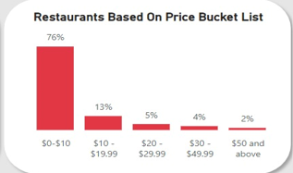
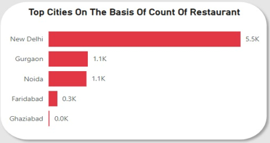
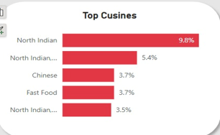
Problems and Analysis
Restaurants ratings: Since the average rating is relatively low that is 2.9, a focus on quality improvement is crucial. Implementing regular staff training programs, introducing quality control checks, and creating a robust customer feedback system can help address this.
Pricing Strategy: With 76% of the restaurants in the $0-$10 price range, introduce premium menu options, exclusive experiences, and upselling techniques to attract higher-spending customers and increase revenue.
Cities and cuisines: based on the data, the high concentration of restaurants are in New Delhi(5.5K), the plan is to expand into less crowded cities like Faridabad (0.3K)and Ghaziabad(0.0K), which have fewer restaurants than New Delhi. By adding different types of cuisines, like Chinese and Fast Food, in areas where North Indian food is more common, will draw in more customers. This strategy uses insights about market potential, competition, and what customers like to improve restaurant locations and boost visits.

Slide 6
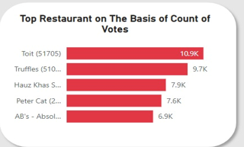


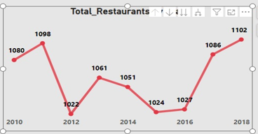
Problems and Analysis
Restaurants based on votes counts: Examine how highly-voted restaurants like "Toit“(10.9K) and "Truffles“(9.7K) engage their customers successfully. Use their successful strategies in marketing to boost the visibility and reputation of other restaurants.
Total restaurants: To grow the current 9,551 restaurant partners by teaming up with local events and businesses. This will attract more customers and build brand loyalty.
Online services: Right now, only 12% of restaurants let customers book tables online and 26% offer online delivery. Expanding these online services can meet the growing demand for convenience and help increase the share of the market.
Total Restaurants by Year :The number of restaurants fluctuates from 2010 to 2018.The highest number of restaurants opened was in 2018 (1102), while the lowest was in 2014 (1024). Fluctuations in restaurant openings can be caused by economic conditions, shifts in market demand, regulatory changes, competition, seasonal factors, investment trends, and economic cycles and adjust strategies to stabilize and enhance growth.

Slide 7
Conclusion
Improve Quality: Implement staff training, quality control, and customer feedback systems.
Adjust Pricing: Introduce premium menu options and upselling techniques.
Expand Locations: Open in less crowded cities like Faridabad and Ghaziabad.
Diversify Cuisines: Introduce a variety of cuisines like Chinese and Fast Food.
Boost Marketing: Strengthen social media presence and partner with local events to increase visibility and loyalty.
Data-Driven Decisions: Continually analyze customer preferences, market trends, and competitive landscape to make informed decisions. Regularly updating the dashboard with new data and insights can help in agile decision-making and strategy adjustments.

Slide 8
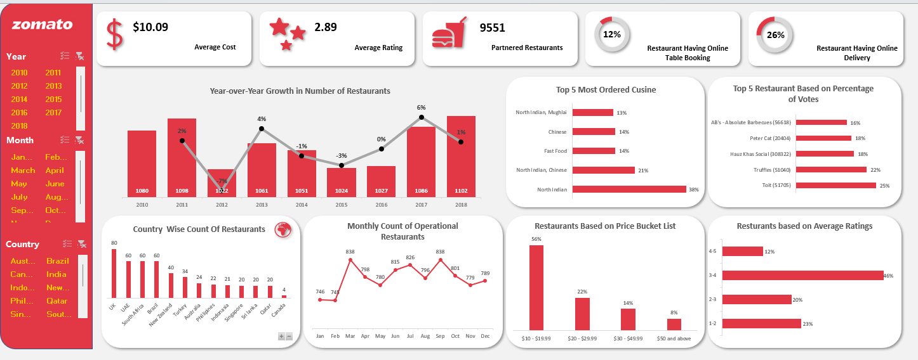
Dashboard (Excel)

Slide 9
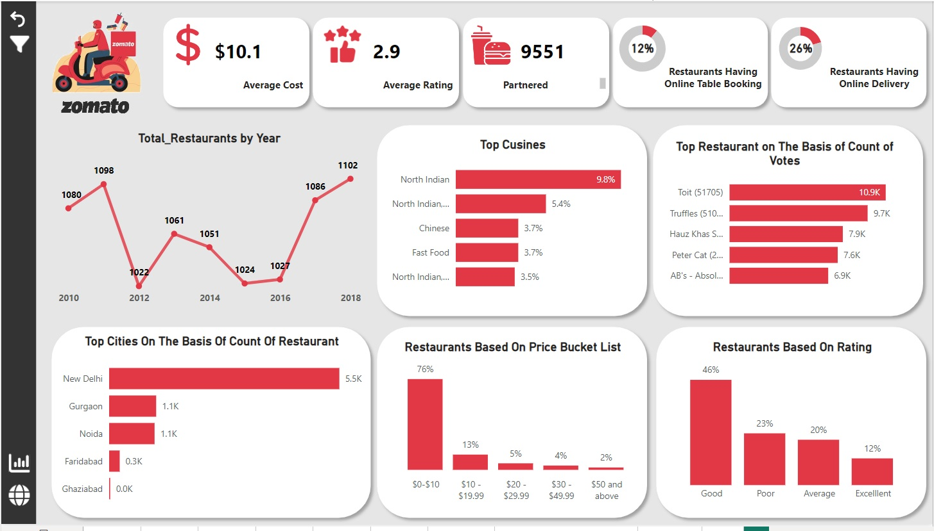
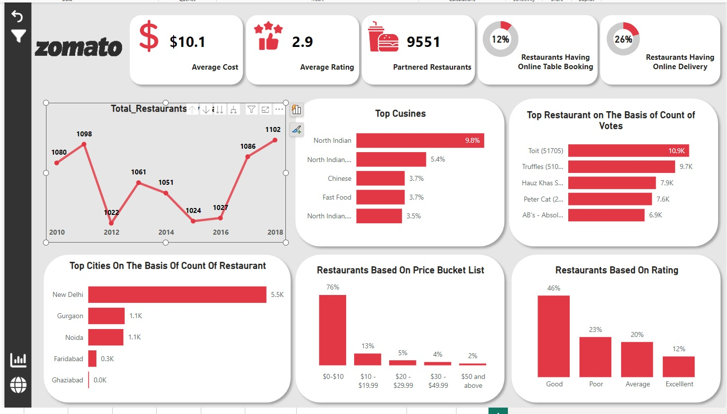
Dashboard (Power BI)

Slide 10
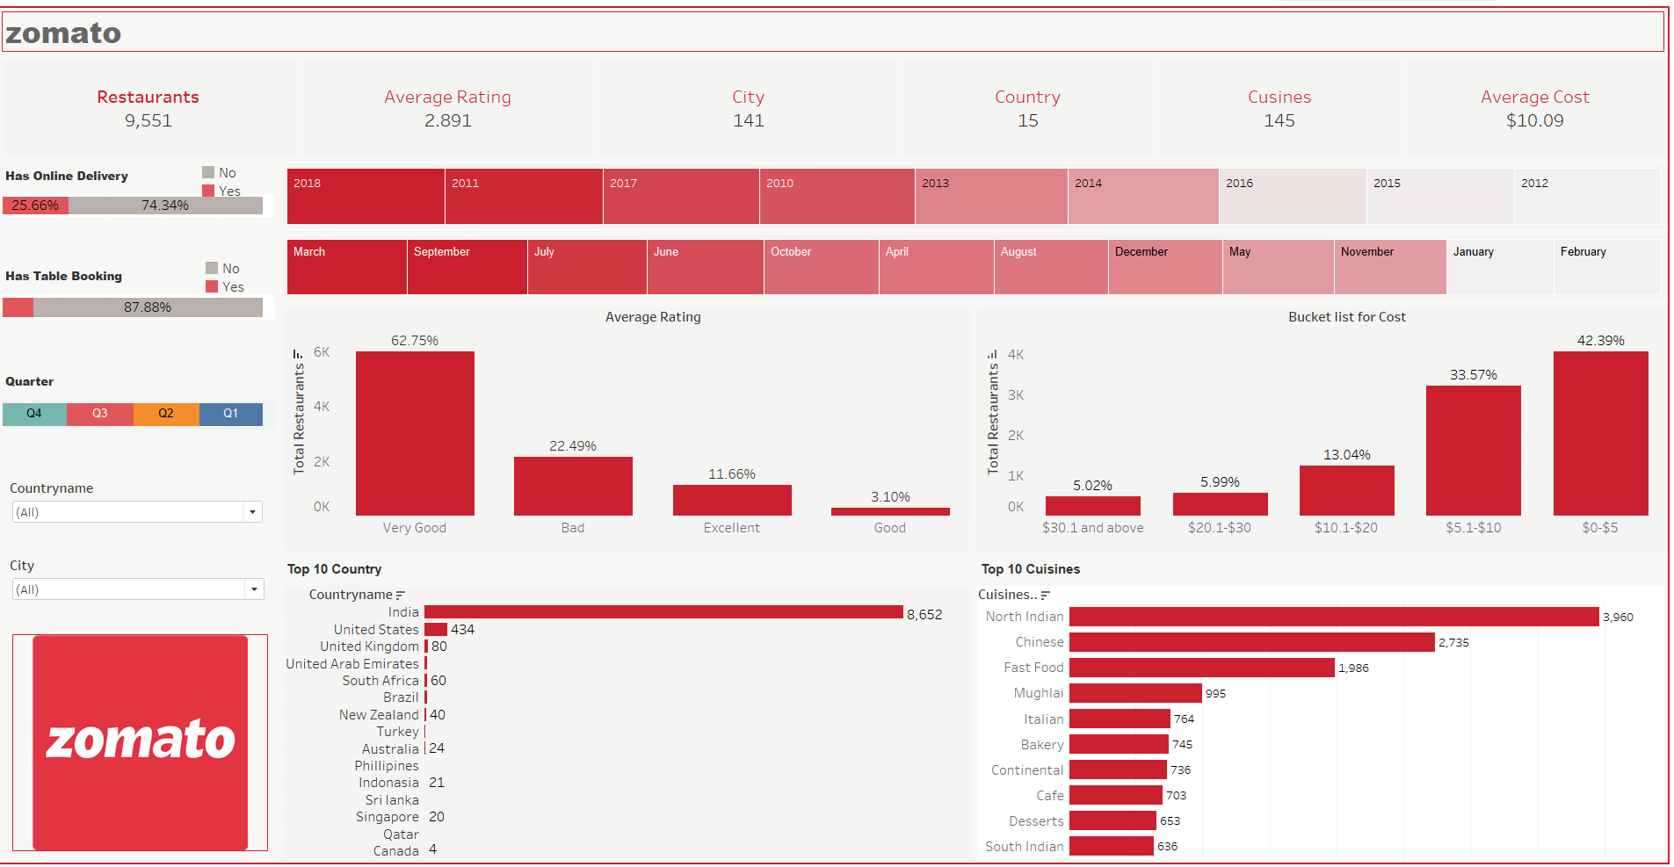
Dashboard (Tableau)

Slide 11


